Slide 1
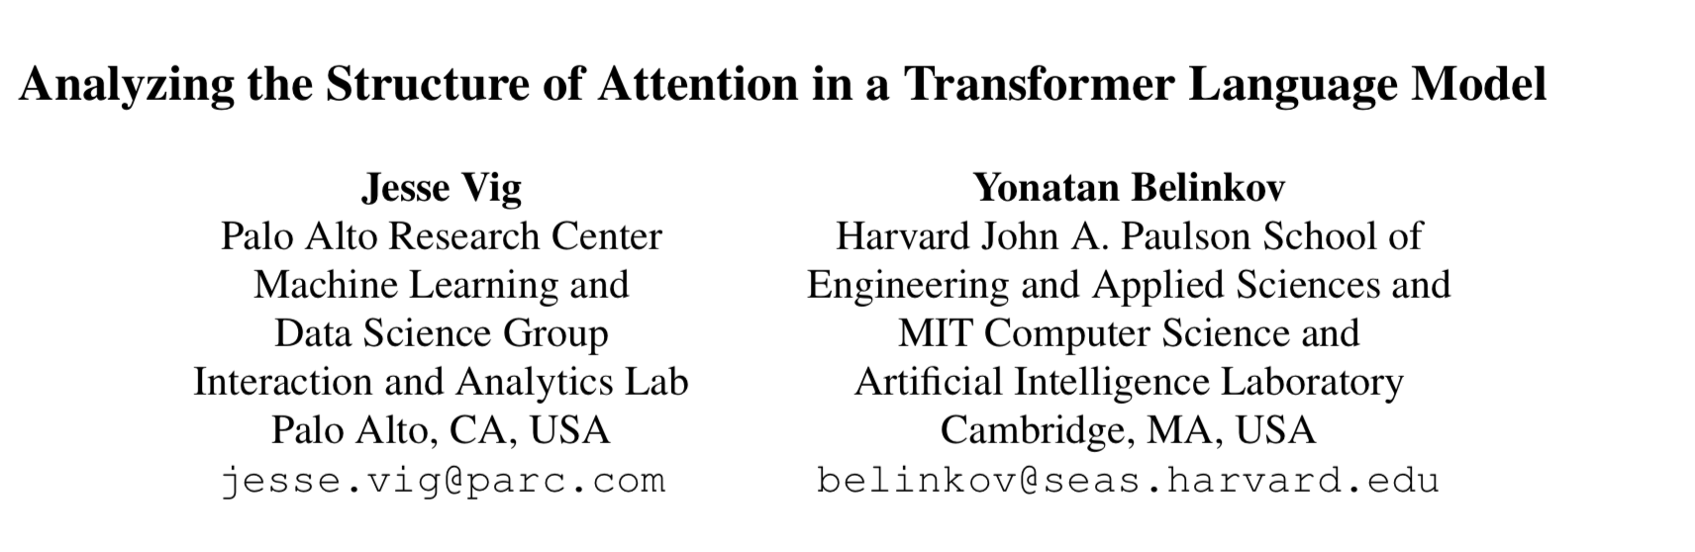
Presented by Shuang Guo

Slide 2
Motivation
From Transformer to Pretrained Language Model
Based on previous visualization technique on Transformer

Slide 3
Problems
Does attention align with syntactic dependency relations?
Which attention heads attend to which part-of-speech tags?
How does attention capture long-distance relationships versus short-distance ones?

Slide 4
Answers
Attention follows dependency relations most strongly in the middle layers of the model
Attention heads target particular parts of speech depending on layer depth
Attention spans the greatest distance in the deepest layers, but varies significantly between heads

Slide 5
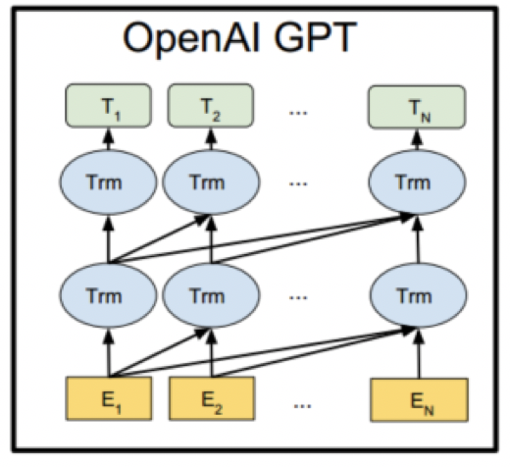
Transformer Architecture
GPT-2 is a stacked decoder Transformer
Attention in GPT-2 is right-to-left

Slide 6
Visualization
Visualizing Individual Inputs
Attention-head View
Model View
Neuron View
Analyzing Attention in Aggregate
Part-of-Speech Tags
Dependency Relations
Attention Distance

Slide 7
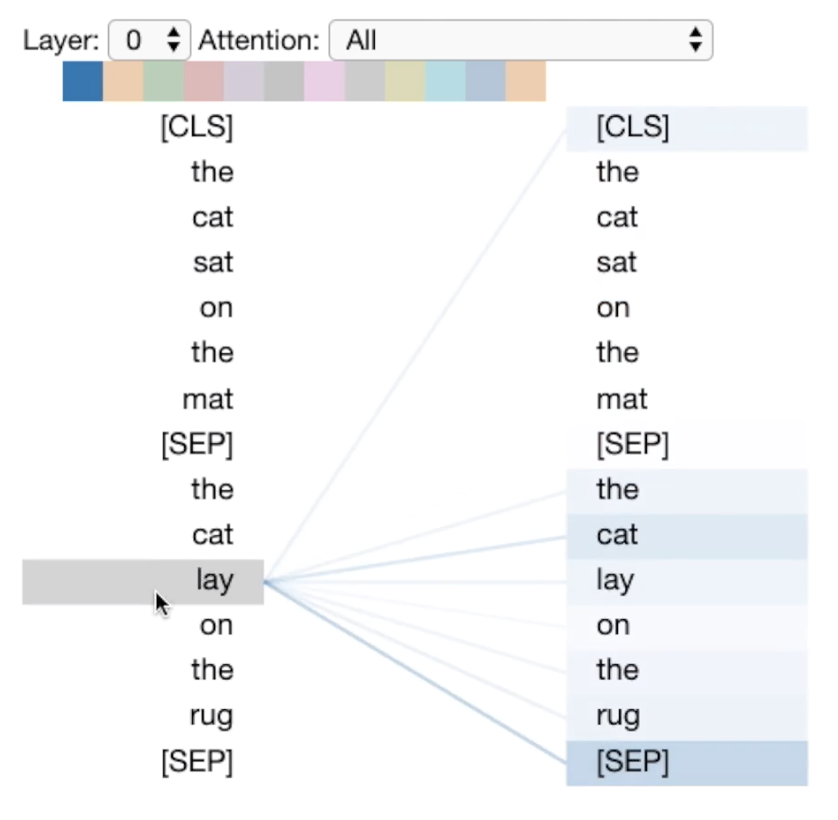
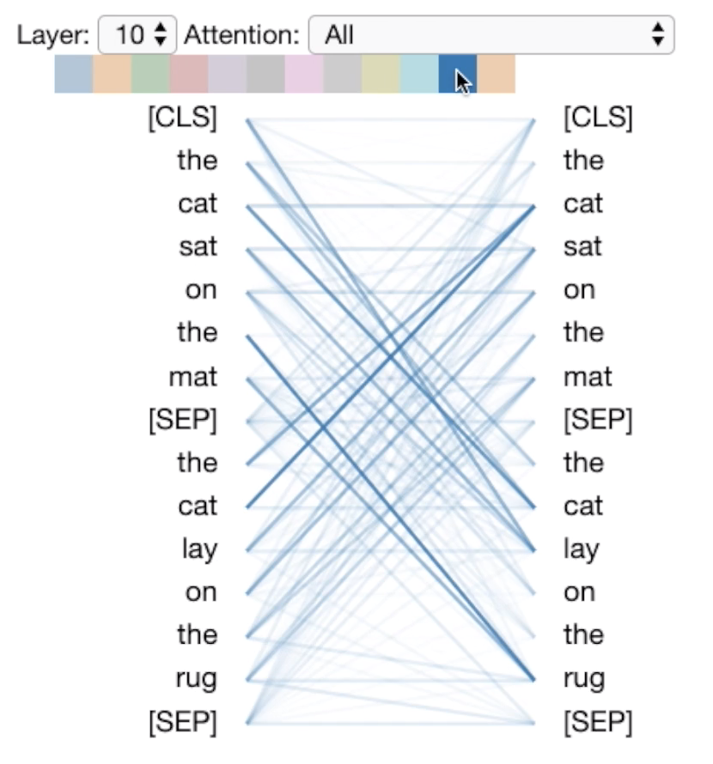
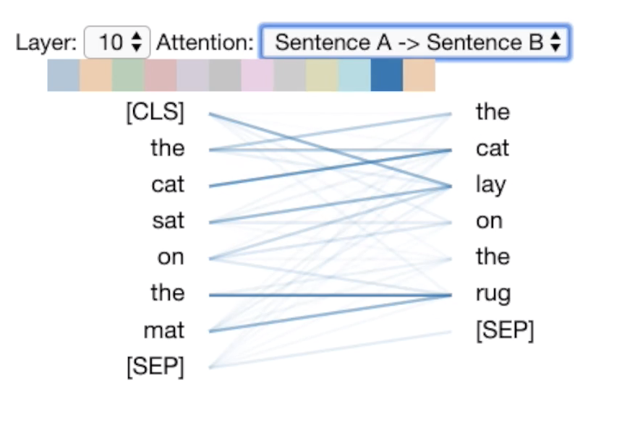
Attention-head View
Colors: heads
line weight: attention weight

Slide 8
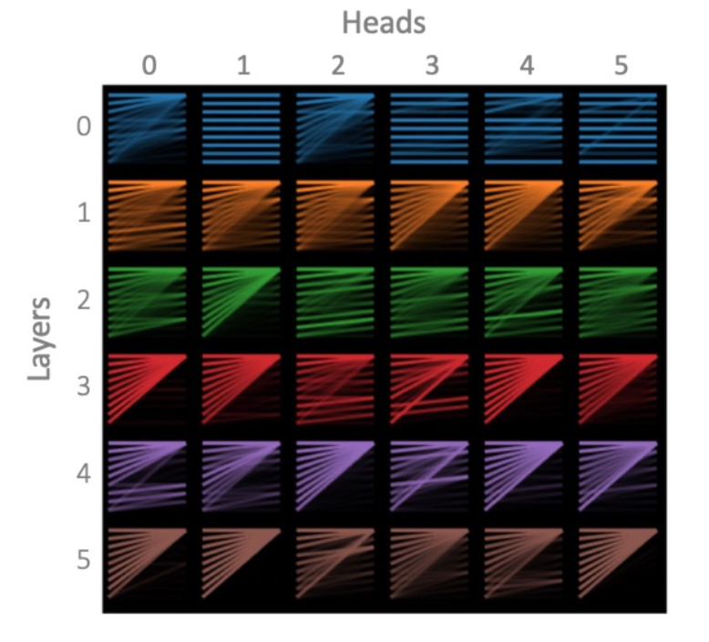
Model View
Users may also click on any head to enlarge it and see the tokens.
For example, several heads in layer 0 share a horizontal-stripe pattern, indicating that tokens attend to the current position. Other heads have a triangular pattern, showing that they attend to the first token.

Slide 9
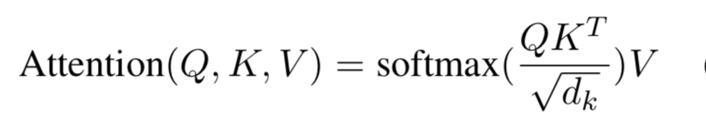
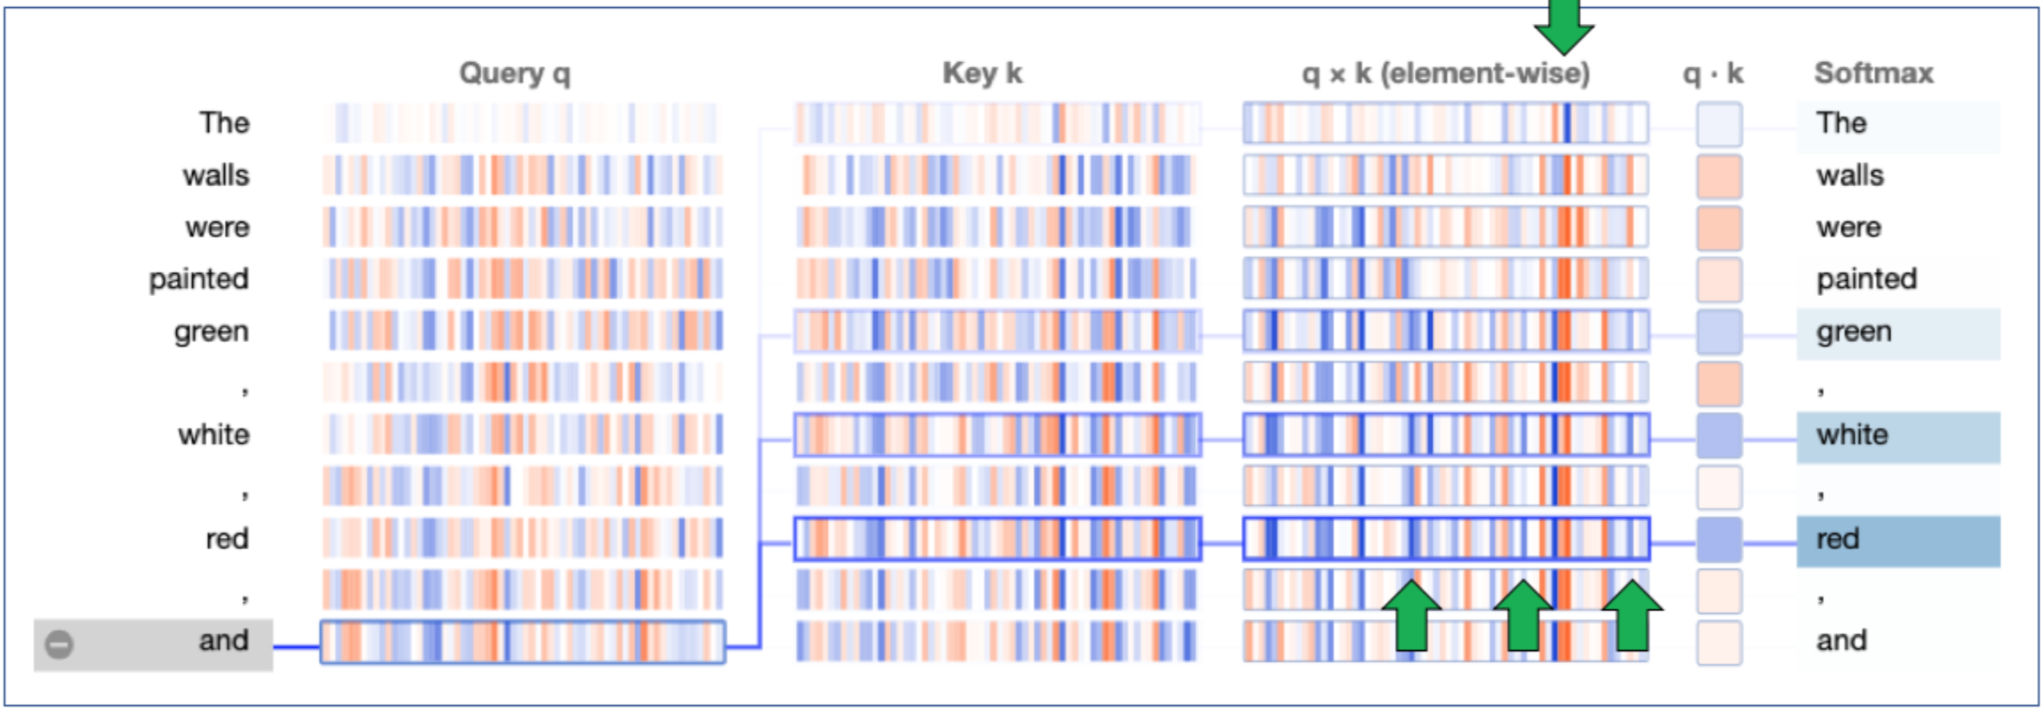
Neuron View
The lower arrows point to neurons that contribute to attention towards list items, while the upper arrow identifies a neuron that helps focus attention on the first token in the sequence.

Slide 10
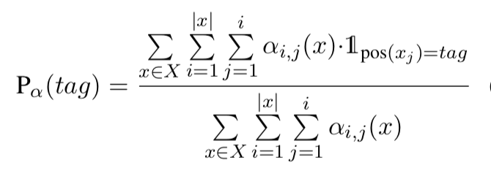
Part-of-Speech Tags

Slide 11
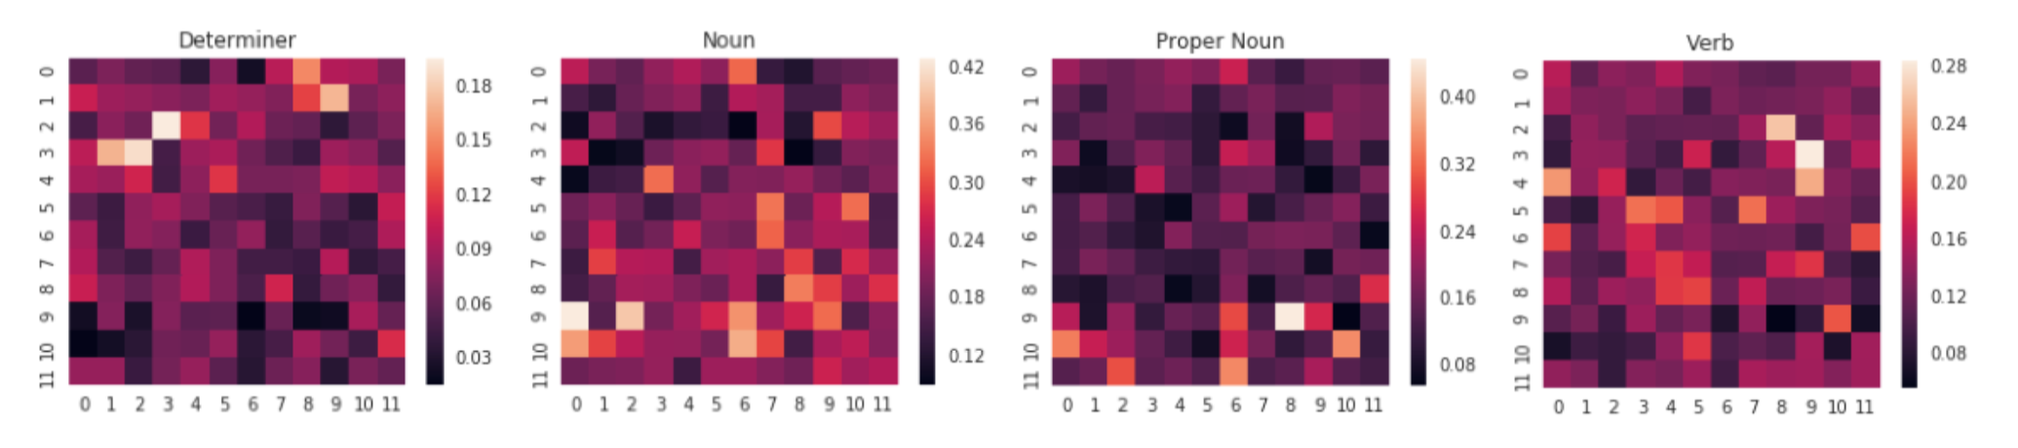
Part-of-Speech Tags
the proportion of total attention directed to the given part of speech, broken out by layer (vertical axis) and head (horizontal axis)

Slide 12
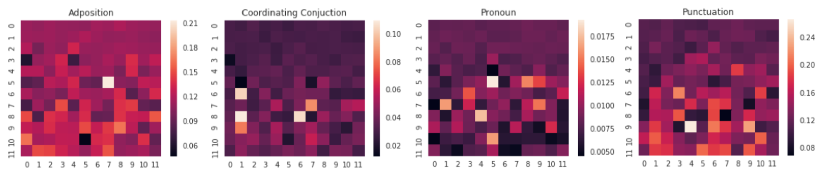
Part-of-Speech Tags
the proportion of total attention that originates from the given part of speech, broken out by layer (vertical axis) and head (horizontal axis)

Slide 13
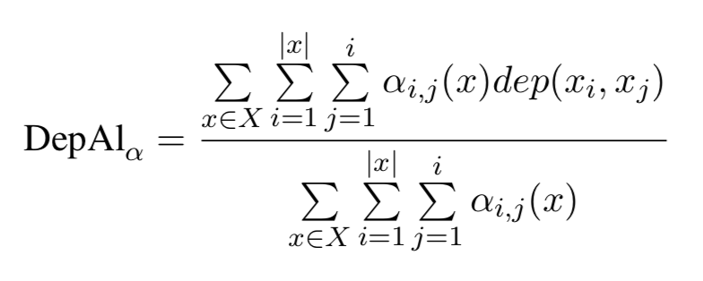
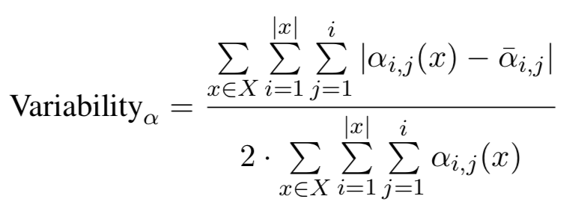
Dependency Relations
dep(xi , xj ) is an indicator function that returns 1 if xi and xj are in a dependency relation and 0 otherwise.

Slide 14
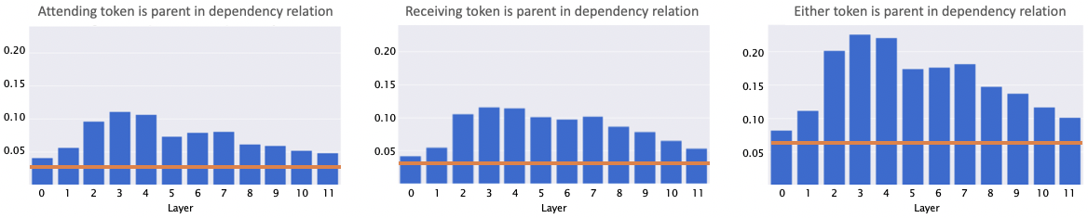
Dependency Relations
Proportion of attention that is aligned with dependency relations, aggregated by layer.
The orange line shows the baseline proportion of token pairs that share a dependency relationship, independent of attention.

Slide 15
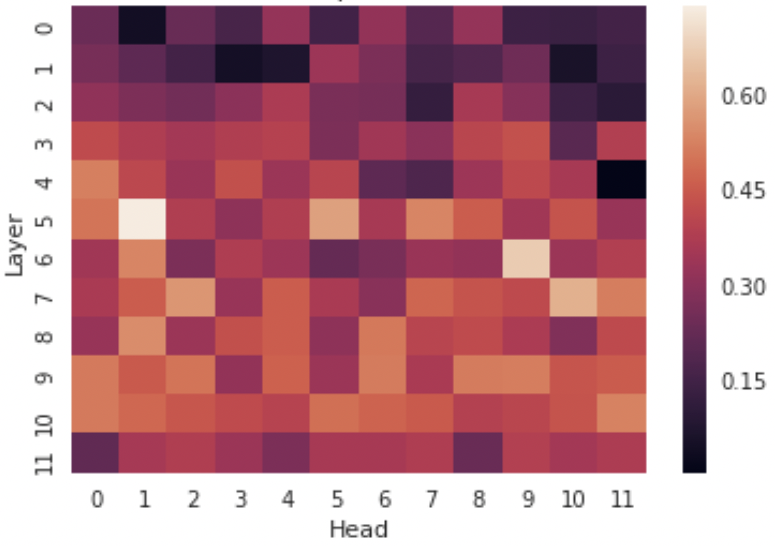
Dependency Relations
Attention variability by layer / head. High-values indicate content-dependent heads, and low values indicate content-independent (position-based) heads.
One possible explanation for the low alignment in the initial layers is that many heads in these layers focus attention based on position rather than content

Slide 16
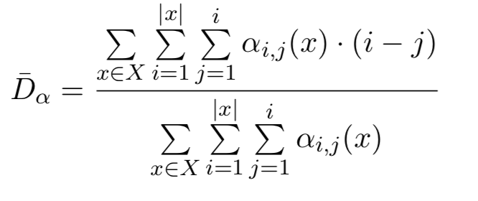
Attention Distance

Slide 17
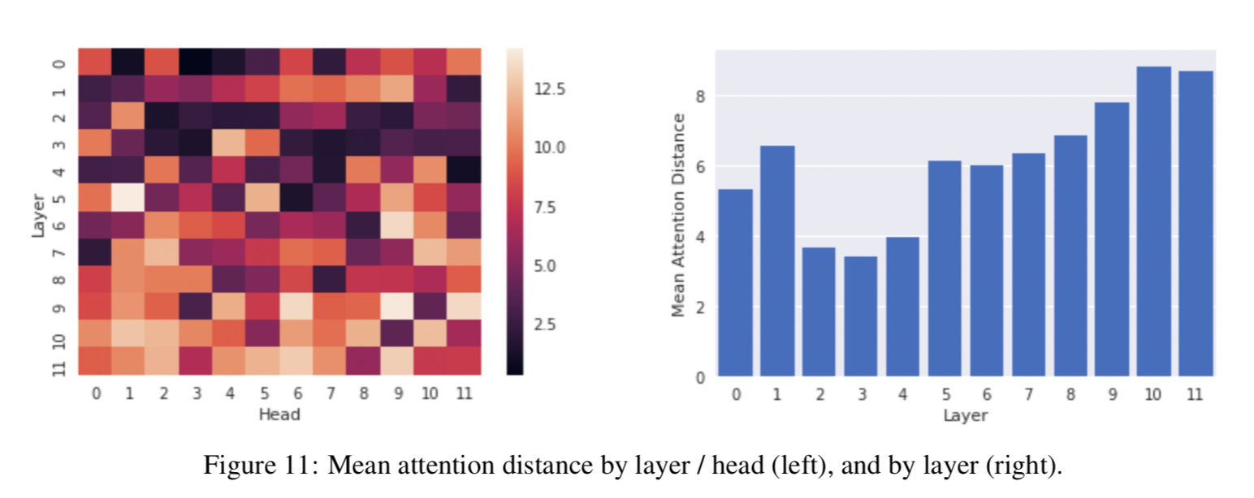
Attention Distance
We found that attention distance is greatest in the deepest layers (Figure 11, right), confirming that these layers capture longer-distance relationships.

Slide 18
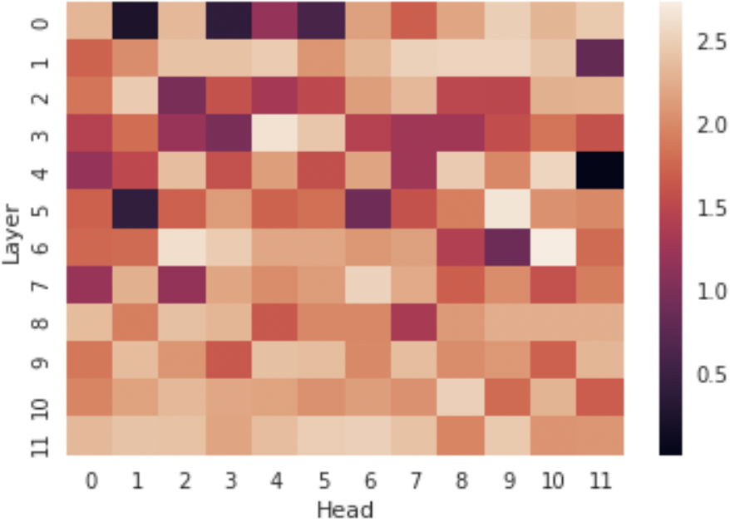
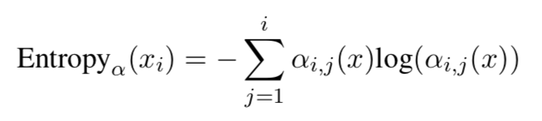
Attention Distance
Mean attention entropy by layer / head. Higher values indicate more diffuse attention.

Slide 19
Experiment detail
Dataset
English Wikipedia, which was not included in the training set
extracted 10,000 articles, and then sampled 100,000 sentences from these articles
Tools
GPT-2 small model
spaCy
pytorch
Filtering Null Attention

Slide 20
Conclusion
Attention heads specialize in particular part-of-speech tags and that different tags are targeted at different layer depths
Deepest layers capture the most distant relationships
Attention aligns most strongly with dependency relations in the middle layers where attention distance is lowest
Structure of attention is closely tied to the training objective
Attention often fo- cused on words most relevant to predicting the next token in the sequence

Slide 21
Future work
Analyze attention patterns in text much longer than a single sentence: Transformer-XL
Bidirectional architecture: BERT
Different types of content: dialog scripts or song lyrics

